Slide 1

field usability test
Notes:
Intro & team - 30 sec
Overview - 30 sec
Prototype changes - 30 sec
Participants - 30 sec
Apparatus - 30 sec
Procedure - 1 min
Tasks - 30 sec
Test measures - 30 sec
Results - 1.5
Discussion - 5 min (4-6 changes)
Summary - 30 sec

Slide 2
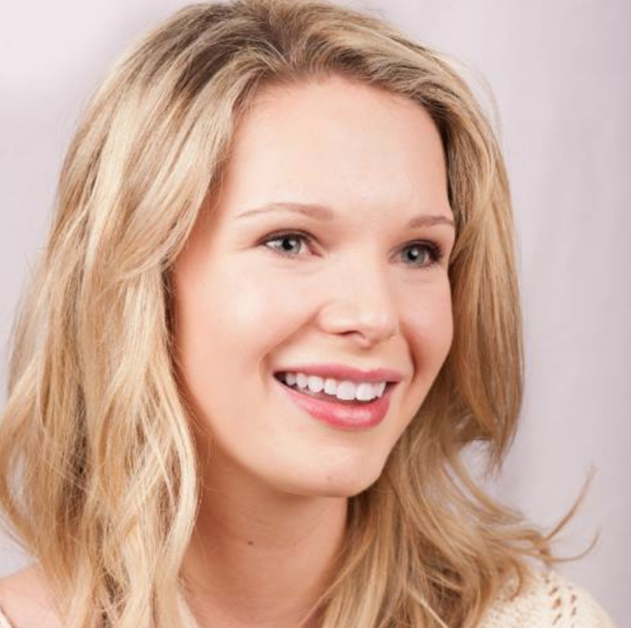
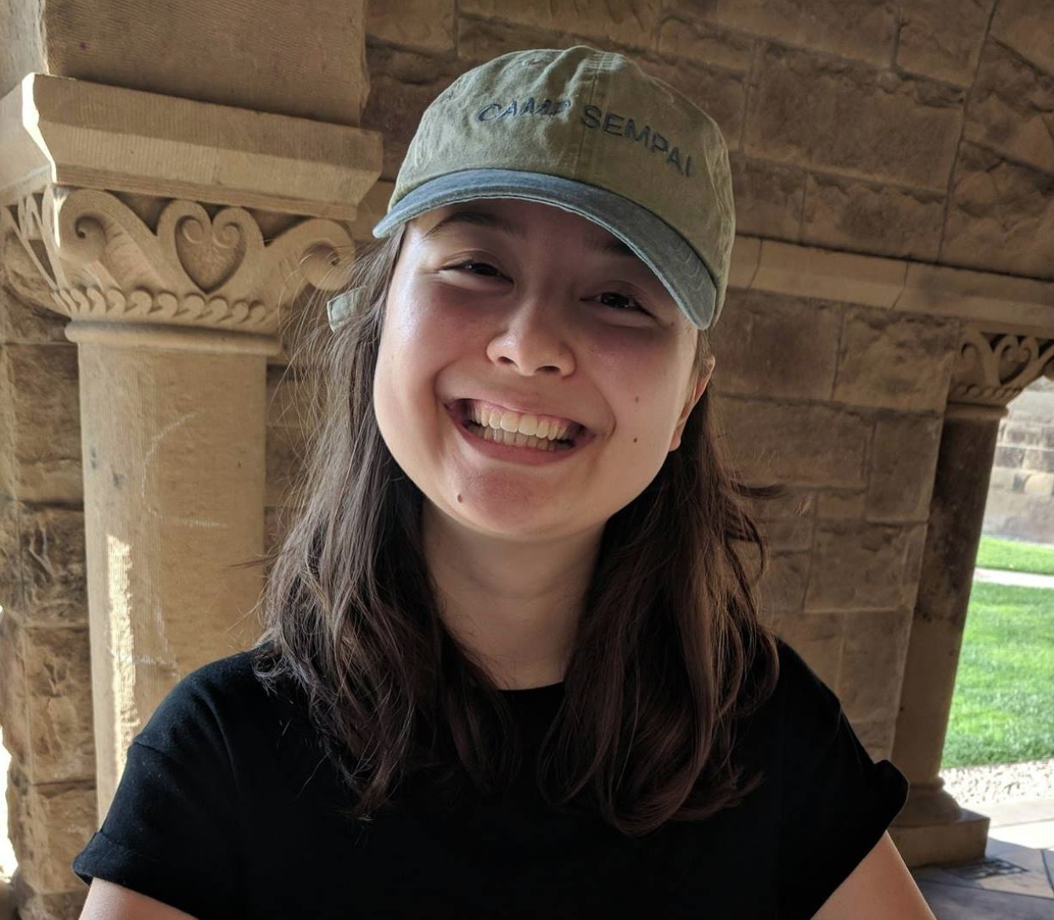
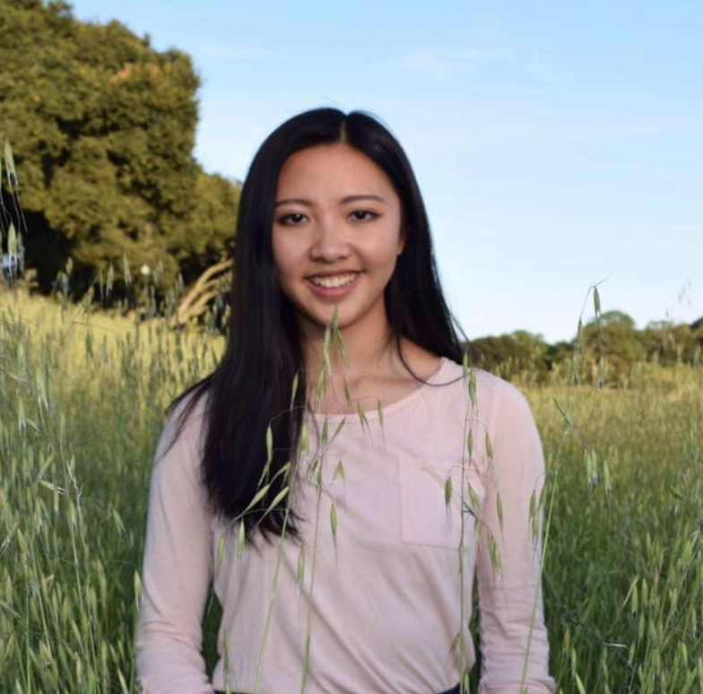
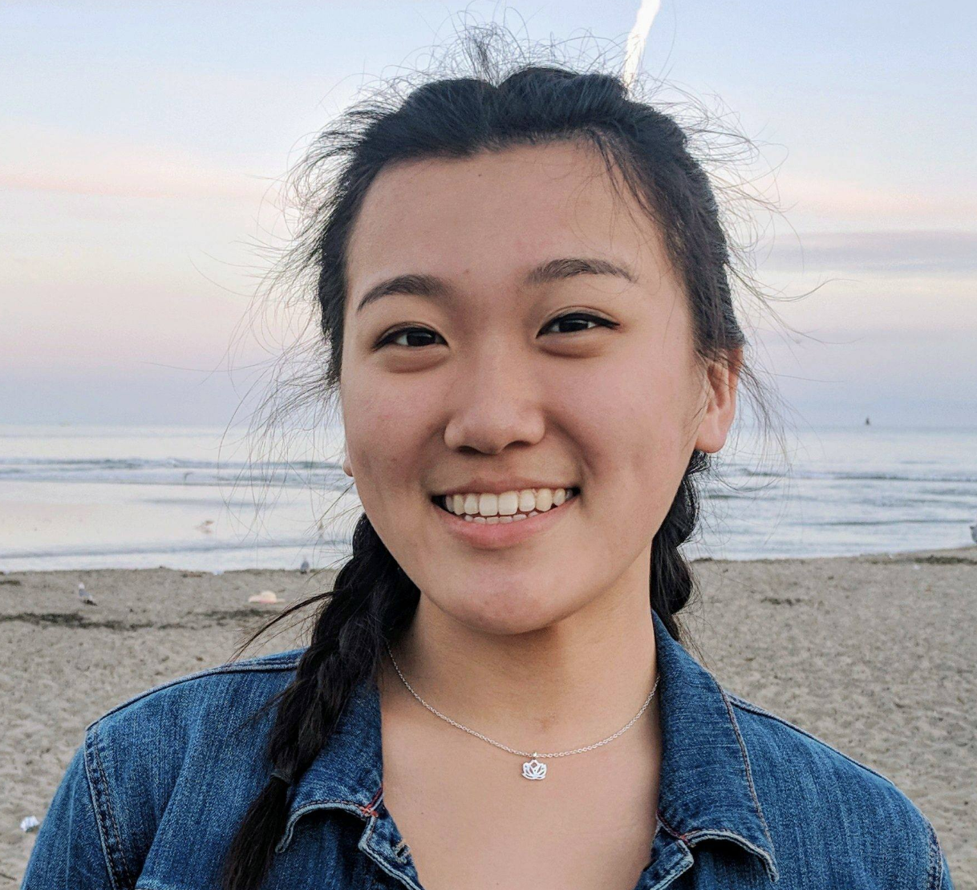
meet the team
Taylor Bacon
Chloe Barreau
Cynthia Liang
Jenny Zhi

Slide 3
declutter meaningfully
People often find themselves keeping a lot of clutter. Many of these objects stay because they hold sentimental value, but not necessarily functional use.
Flutter adds emotional security to the decluttering process, allowing people to find others who will value or add meaning to the item.
value proposition
problem
solution

Slide 4
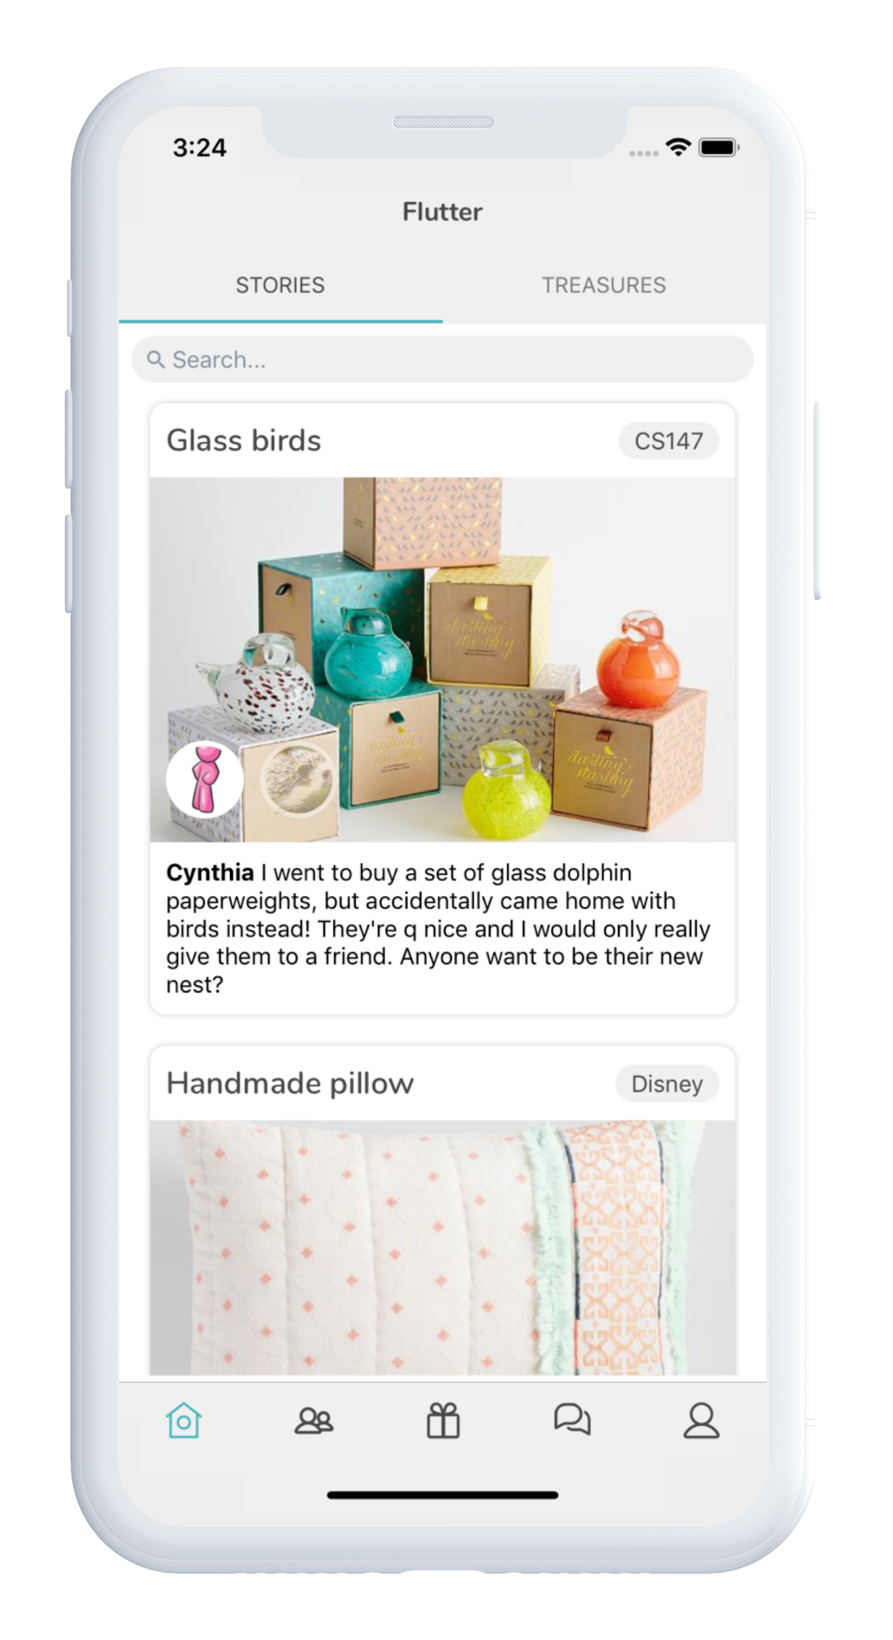
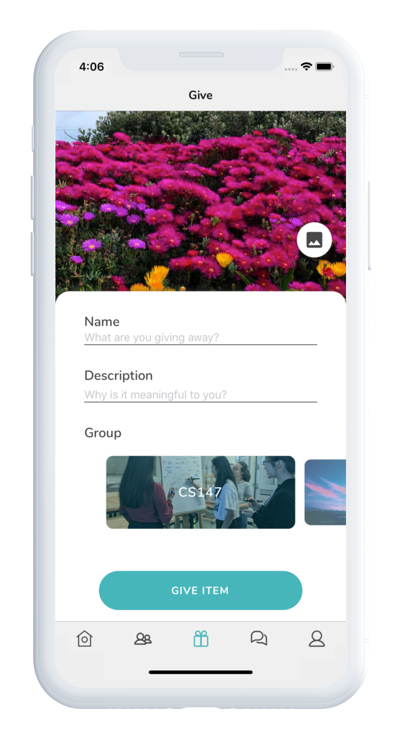
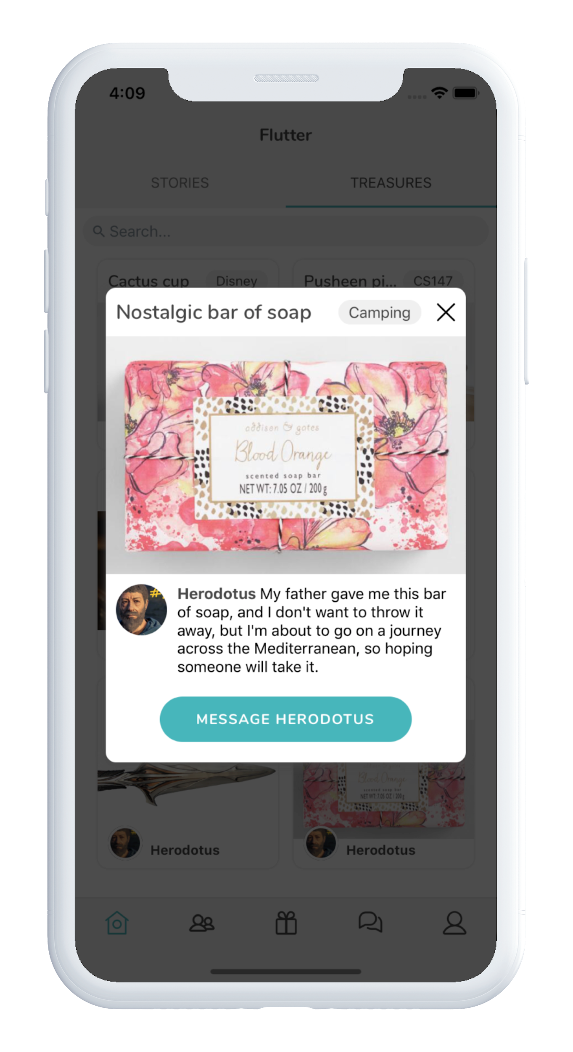
Notes:
How does flutter encourage receivers of treasured objects to share their side of the story?

Slide 5
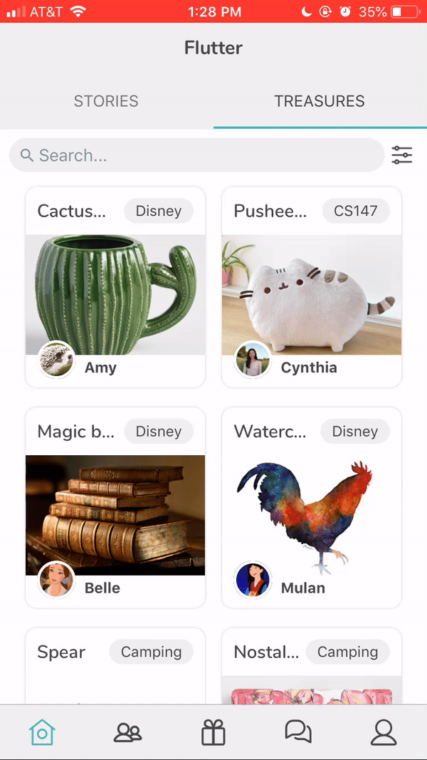
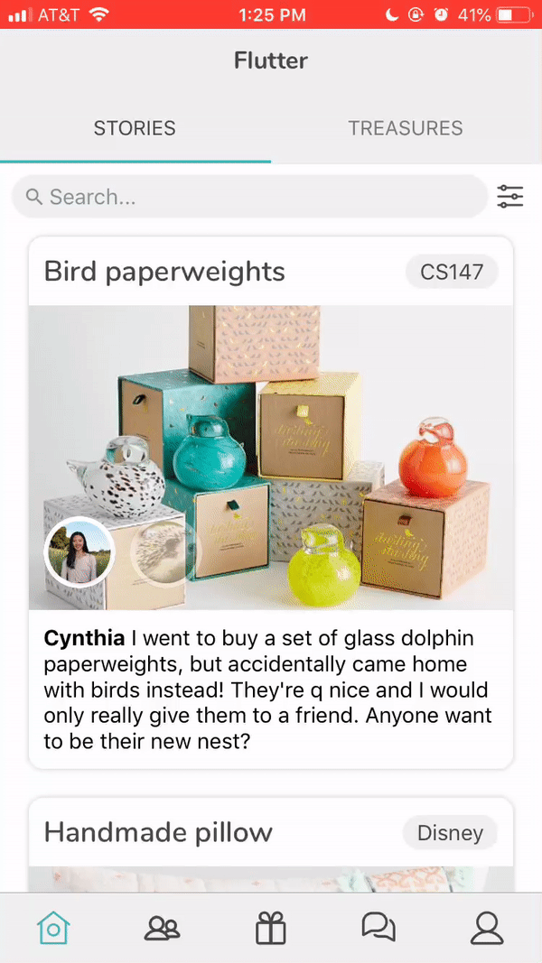
test new interface changes:
search + community filters
new task flows
chat
error handling
get insights about:
user base
applicability
goals

Slide 6
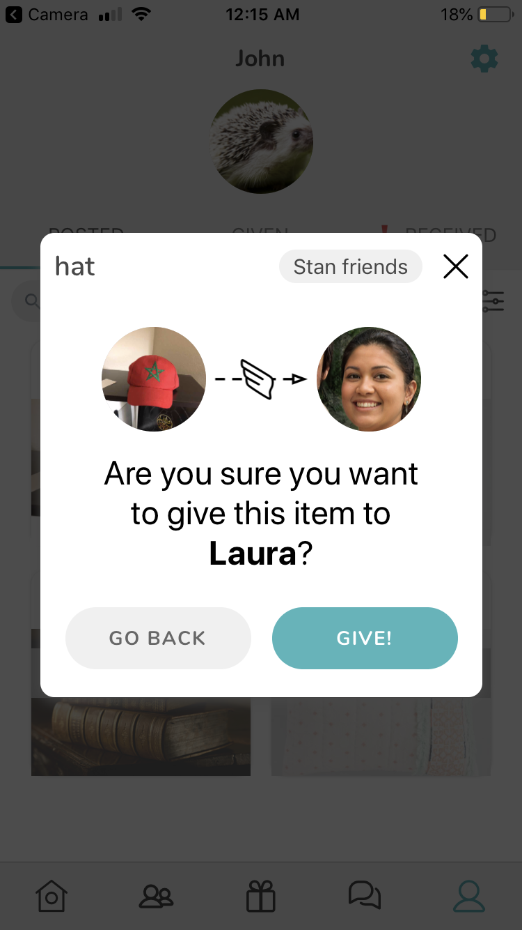
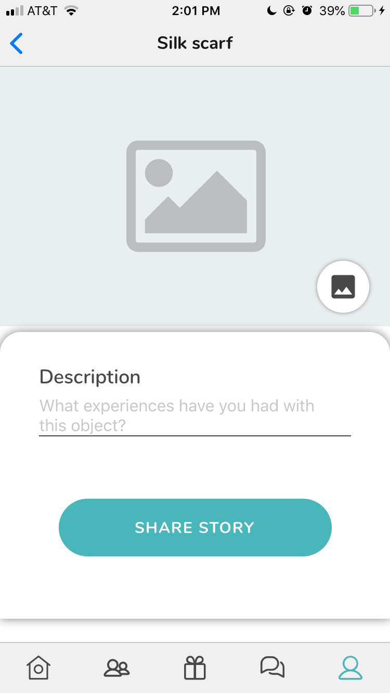
test new interface changes:
search + community filters
new task flows
chat
error handling
get insights about:
user base
applicability
goals

Slide 7
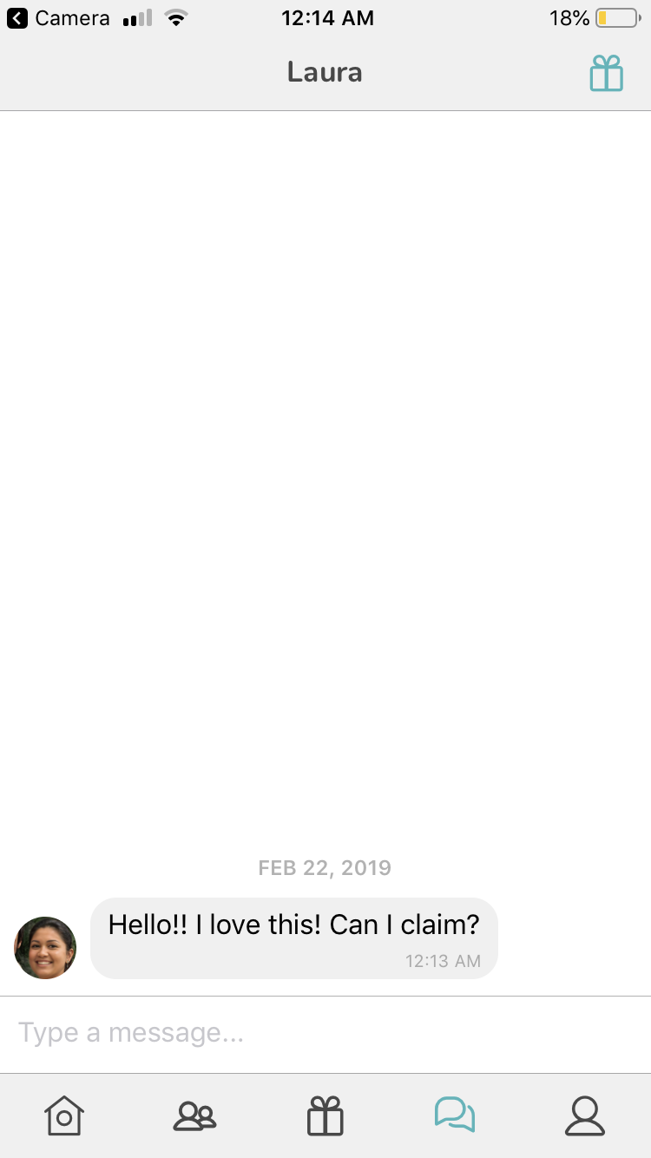
test new interface changes:
search + community filters
new task flows
chat
error handling
get insights about:
user base
applicability
goals

Slide 8
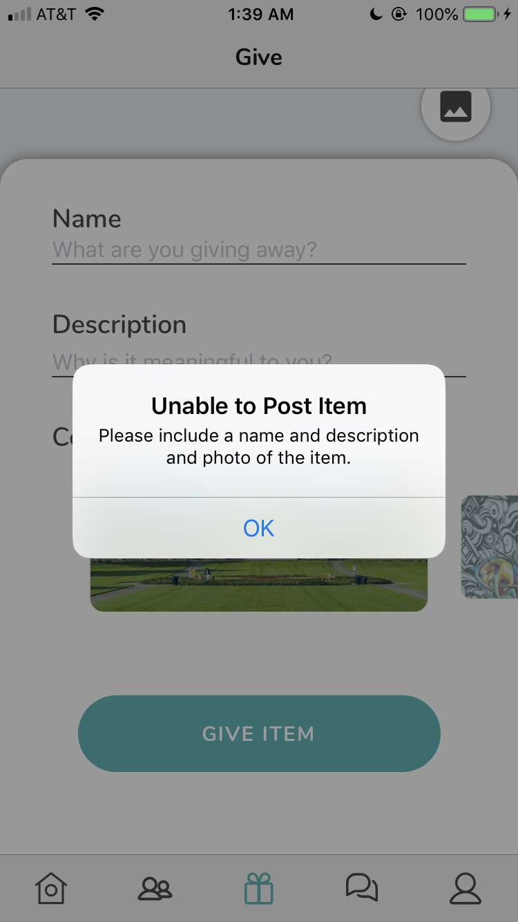
test new interface changes:
search + community filters
new task flows
chat
error handling
get insights about:
user base
applicability
goals

Slide 9



test new interface changes:
search + community filters
new task flows
chat
error checking
get insights about:
user base
applicability
goals

Slide 10
method
results
discussion
participants
apparatus
procedure
tasks
test measures
in-situ insights
goals, revisited
changes
future testing

Slide 11
method
method
method
results
results
discussion
discussion

Slide 12
method
method
results
results
discussion
discussion
participants
sample size
n=6
gender
3 male, 3 female
age
~ 20-50 years old
recruitment
convenience sampling of first/second degree connections
compensation
chocolate rabbit received during experiment
tech experience
range of tech/app/social media usage

Slide 13
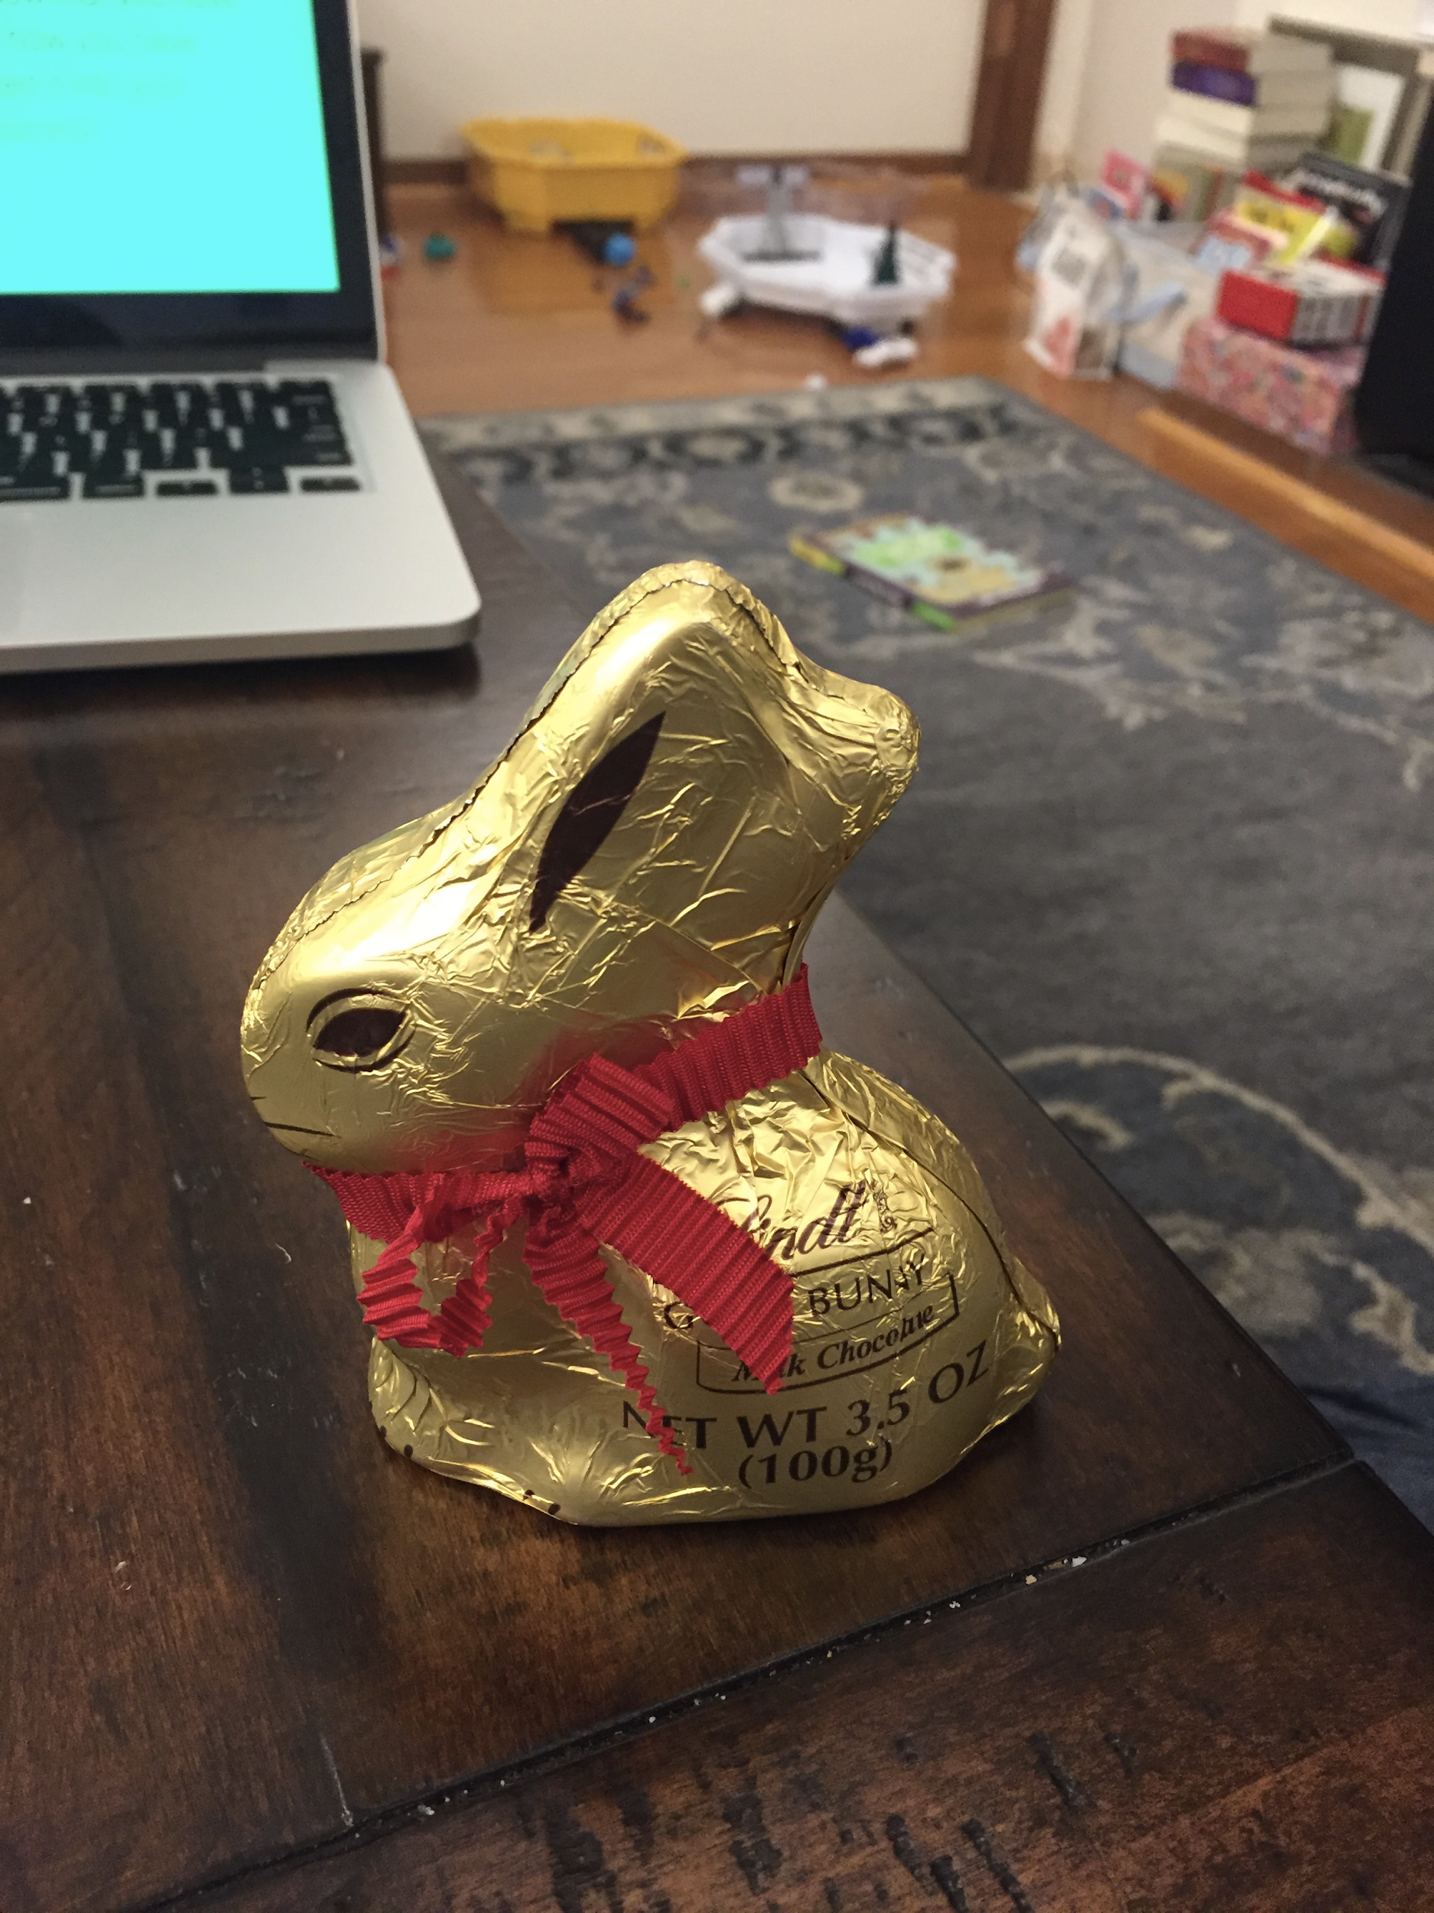
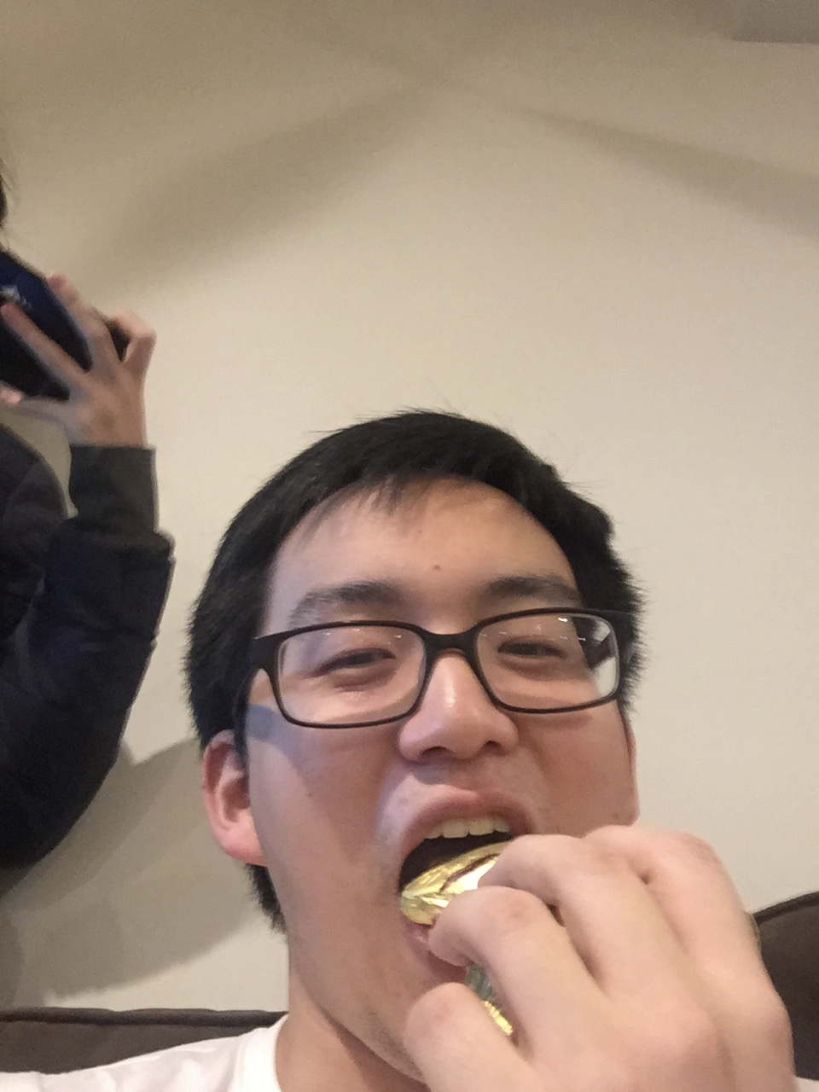
method
method
results
results
discussion
discussion
participants
sample size
n=6
gender
3 male, 3 female
age
~ 20-50 years old
recruitment
convenience sampling of first/second degree connections
compensation
chocolate rabbit received during experiment
tech experience
range of tech/app/social media usage

Slide 14
method
method
results
results
discussion
discussion
participants
sample size
n=6
gender
3 male, 3 female
age
~ 20-50 years old
recruitment
convenience sampling of first/second degree connections
compensation
chocolate rabbit received during experiment
tech experience
range of tech/app/social media usage

Slide 15


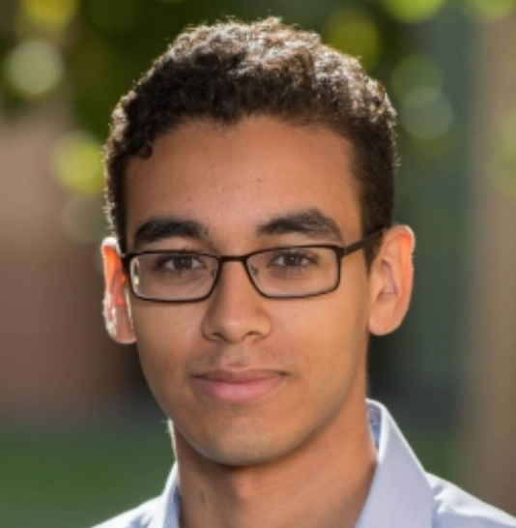



method
results
discussion
participants
participants
Chloe
Jessica
Bilal
Lucy
Dennis
John
undergrads; on-campus dorm housing
grad students; non-dorm campus-affiliated housing
live in independent housing with roommates/family

Slide 16



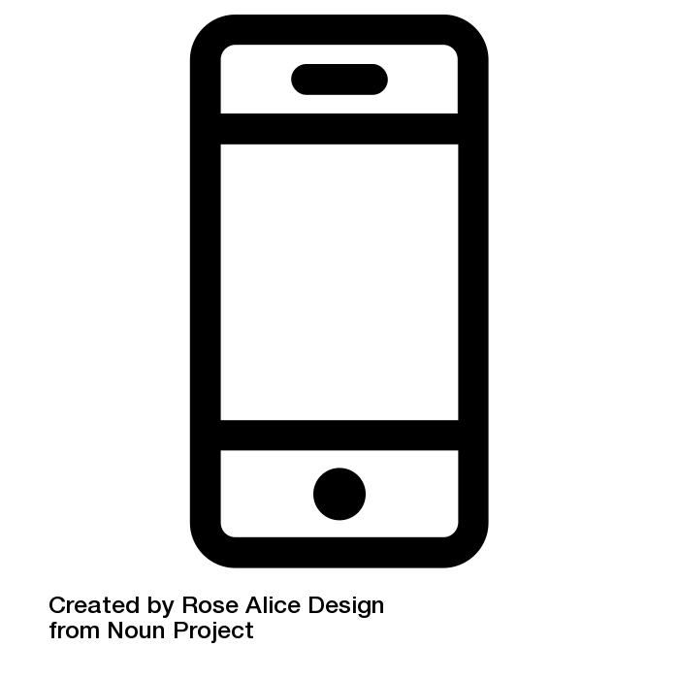
method
results
discussion
apparatus
ran prototype using Expo
recorded screen using Record It!
filmed using mobile phone cameras
ran tests in participants’ living areas

Slide 17
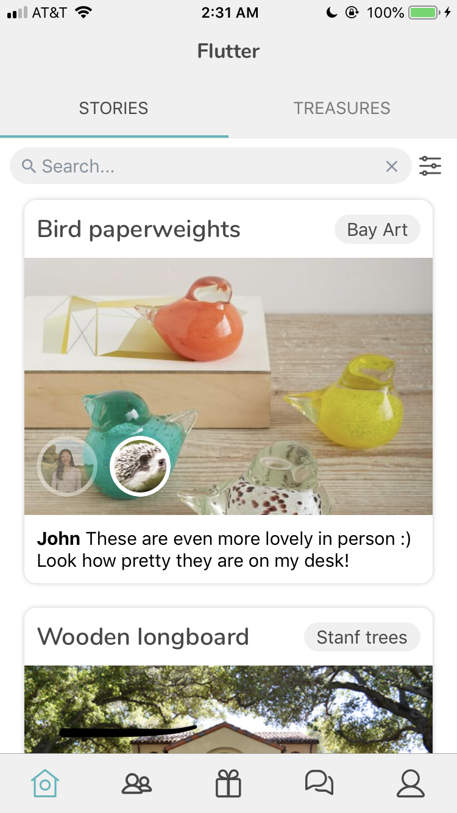
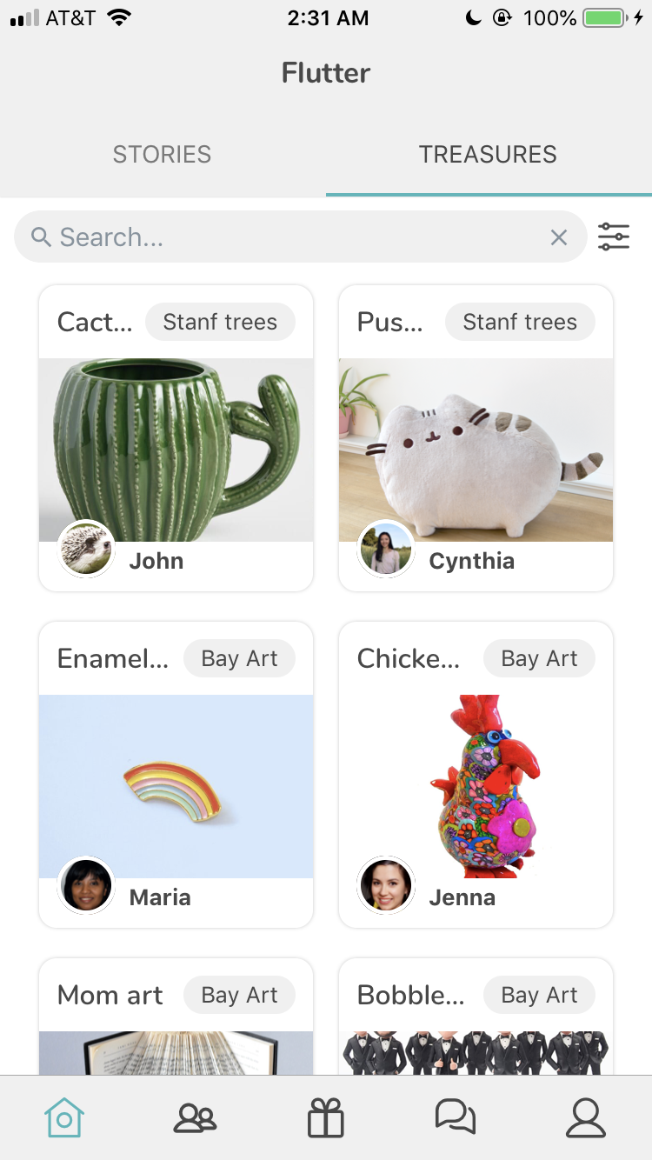
method
results
discussion
brief explanation
demo of treasures and stories cards on home feed
procedure
introduction
tasks
debrief

Slide 18
method
results
discussion
Complexity
Summary
task 1
simple
find a specific item
procedure
introduction
tasks
debrief
task 2
complex
respond to an unfinished story
task 3
moderate
give a posted item to a friend

Slide 19
method
results
discussion
task 1: find a specific item
procedure
what we looked for:
tapping into ‘treasures’ tab (posted items)
filtering by group?
tapping into ‘communities’ tab?
finding/tapping painting
introduction
tasks
debrief
task 1
task 2
task 3

Slide 20
method
results
discussion
task 2: respond to an unfinished story
procedure
what we looked for:
tapping profile tab tapping received subtab tapping "share story" inserting picture and description
posting story
introduction
tasks
debrief
task 1
task 2
task 3

Slide 21
method
results
discussion
task 3: give a posted item to a friend
subtask 3a: create a new community
procedure
what we looked for:
tapping communities tab tapping "create new community" adding a picture
naming the group
adding at least one member
introduction
tasks
debrief
task 1
task 2
task 3

Slide 22
method
results
discussion
task 3: give a posted item to a friend
subtask 3b: post item
procedure
what we looked for:
tapping ‘give’ tab inserting picture writing name writing description swiping to community
posting item
introduction
tasks
debrief
task 1
task 2
task 3

Slide 23
method
results
discussion
task 3: give a posted item to a friend
subtask 3c: give item to friend in-app
procedure
what we looked for:
tapping + responding to chat
tapping profile->posted subtab
navigating from give icon in chat?
navigating from profile tab? tapping posted item
selecting giftee
gifting item to giftee
introduction
tasks
debrief
task 1
task 2
task 3

Slide 24
skipped slides: w/ detailed task descriptions

Slide 25
method
results
discussion
task 1: find a specific item
description: you’ve recently moved, but there’s an unsightly hole in one of your walls (bay area housing is just too much; this is the best you could get).
find a painting in the bay art community that will remedy this, and message the giver to ask for it.
procedure
introduction
tasks
debrief
task 1
task 2
task 3
what we looked for:
tapping into ‘treasures’ tab (posted items)
filtering by group?
tapping into ‘communities’ tab?
finding/tapping painting

Slide 26
method
results
discussion
task 2: respond to an unfinished story
description: you have recently claimed a chocolate rabbit from a friend. now that you have it, share how you have integrated it into your home/tummy!
procedure
introduction
tasks
debrief
task 1
task 2
task 3
what we looked for:
tapping profile tab tapping received subtab tapping "share story" inserting picture and description
posting story

Slide 27
method
results
discussion
task 3: give a posted item to a friend
subtask 3a: create a new community
description: you’re sorting through your house and cleaning. find something that has sentimental value to you, but you can’t bring with you and would like to actually permanently give it away.
create a new community to give it away to.
procedure
introduction
tasks
debrief
task 1
task 2
task 3
what we looked for:
tapping communities tab tapping "create new community" adding a picture
naming the group
adding at least one member

Slide 28
method
results
discussion
task 3: give a posted item to a friend
subtask 3b: post item
description: post your item to this community on flutter.
procedure
introduction
tasks
debrief
what we looked for:
tapping ‘give’ tab inserting picture writing name writing description swiping to community
posting item
task 1
task 2
task 3

Slide 29
method
results
discussion
task 3: give a posted item to a friend
subtask 3c: give item to friend in-app
description: somebody responded to your post. respond to her message and give the item to her.
procedure
introduction
tasks
debrief
what we looked for:
tapping + responding to chat
tapping profile->posted subtab
navigating from give icon in chat?
navigating from profile tab? tapping posted item
selecting giftee
gifting item to giftee
task 1
task 2
task 3

Slide 30
method
results
discussion
thoughts/feelings about giving away/claiming items
likelihood of these actions normally
thoughts/feelings about in-app interactions
communities to use this app with
final comments
procedure
introduction
tasks
debrief

Slide 31
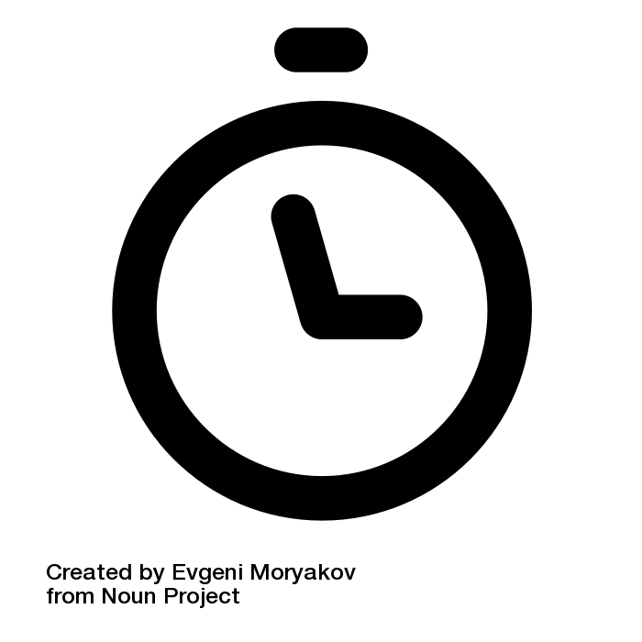



method
results
discussion
test measures
time it takes to complete a task,
manual clickstream data for each tap
number of times user makes an error and/or starts over
number of times user hesitates or expresses confusion
quantitative + qualitative comments about use and value

Slide 32
results
method
results
discussion

Slide 33
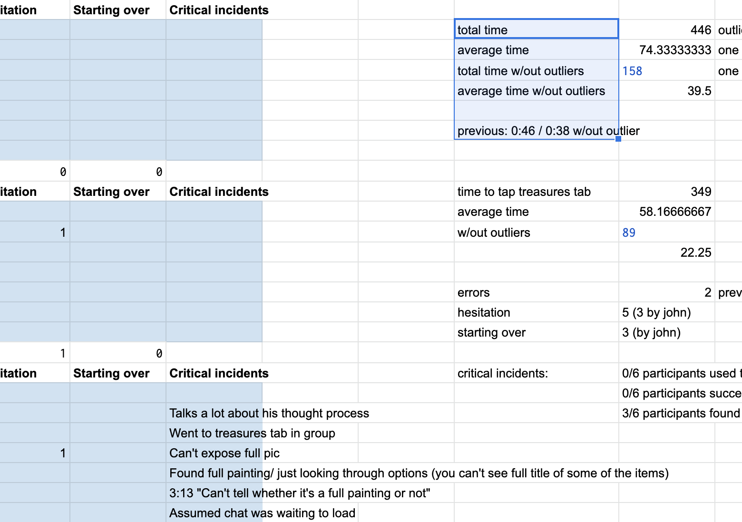
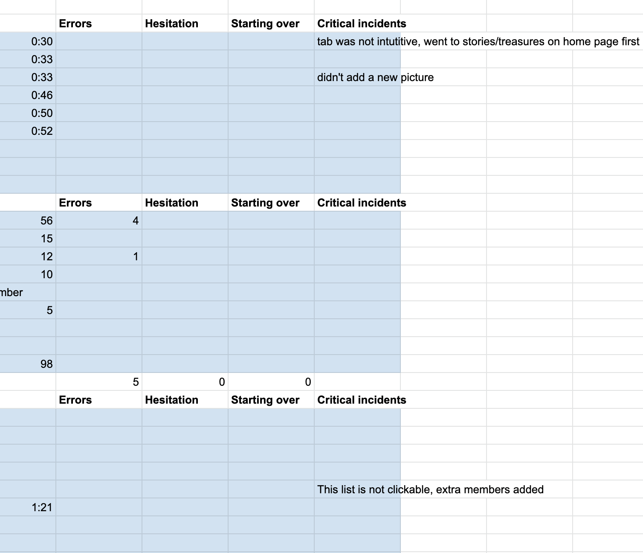
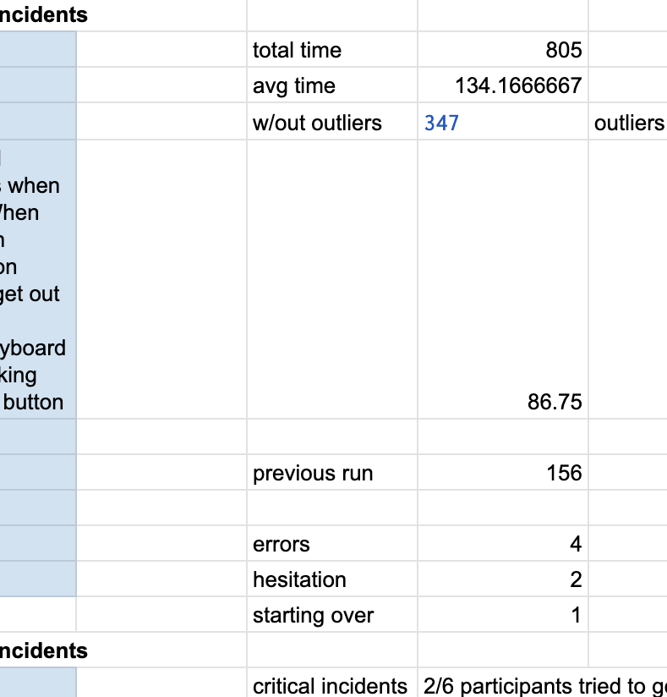
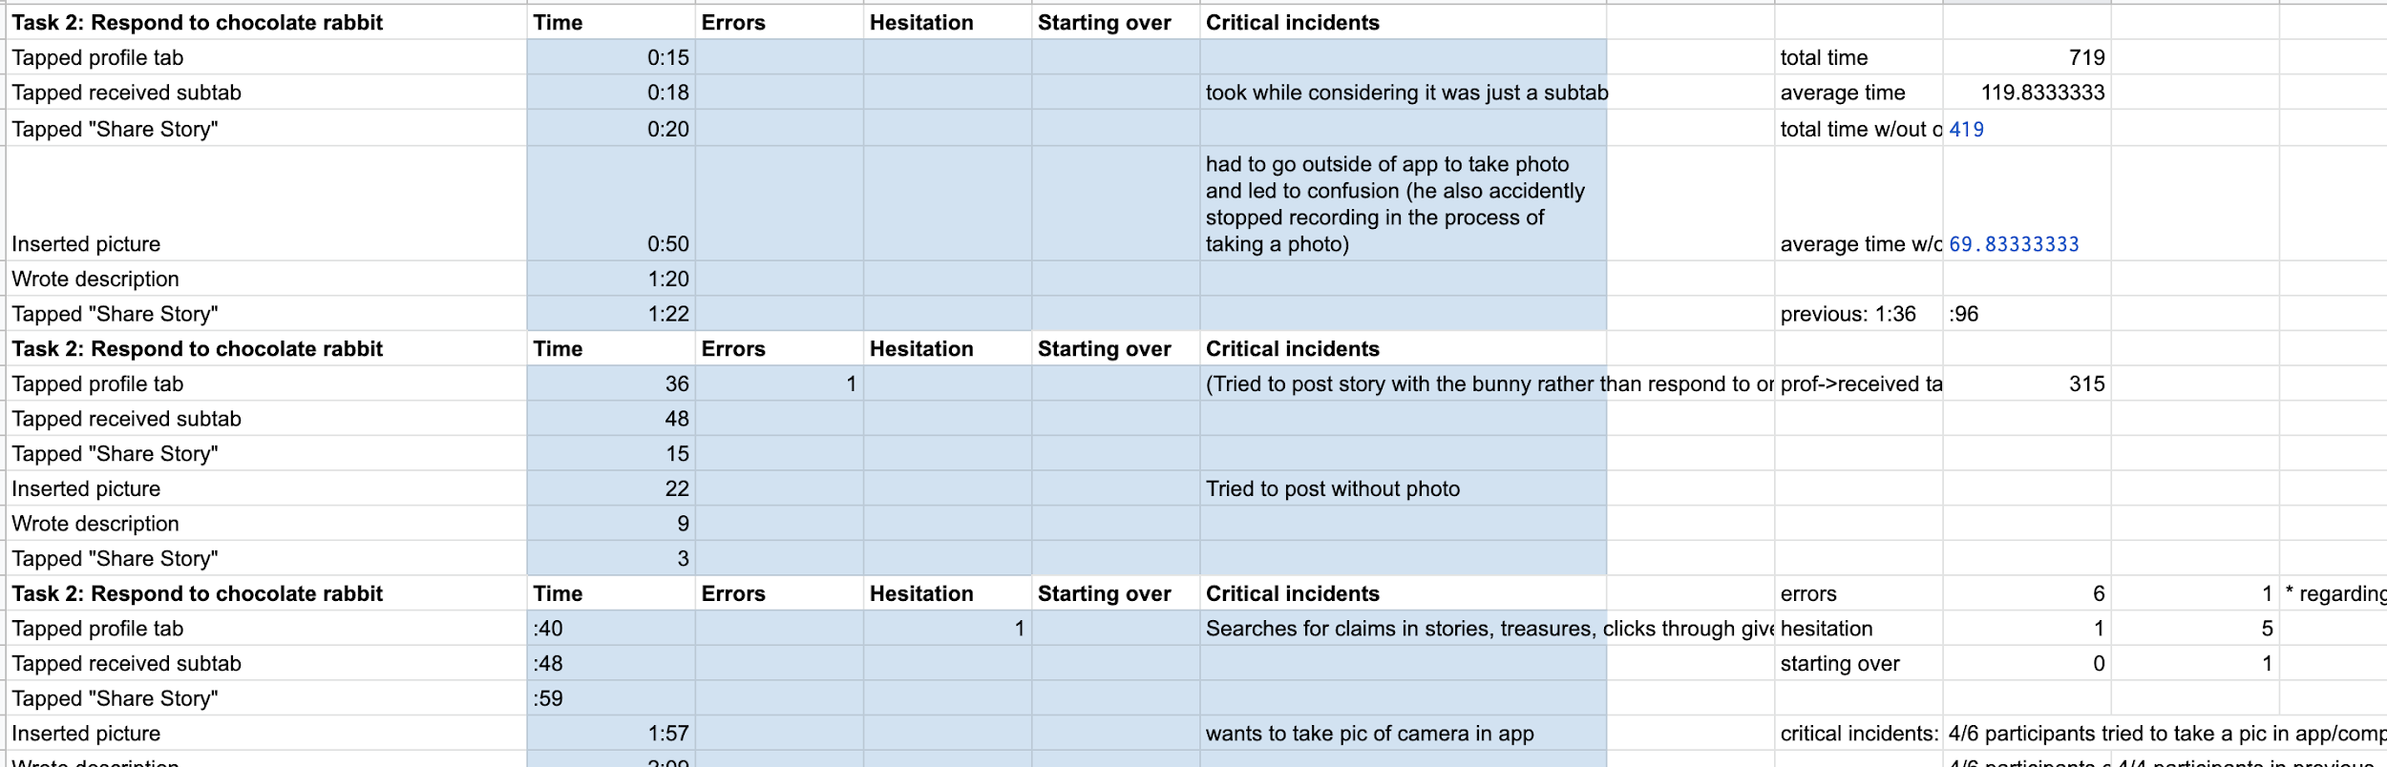
results

Slide 34



method
results
discussion
outliers + critical task points
*
participant x was not very familiar with modern social media app interfaces (affected time + errors/hesitation)
participant y talked extensively and played around with the tasks (affected time)
critical task points are significant subtasks that created knots in participant understanding (affected time + errors/hesitation)

Slide 35
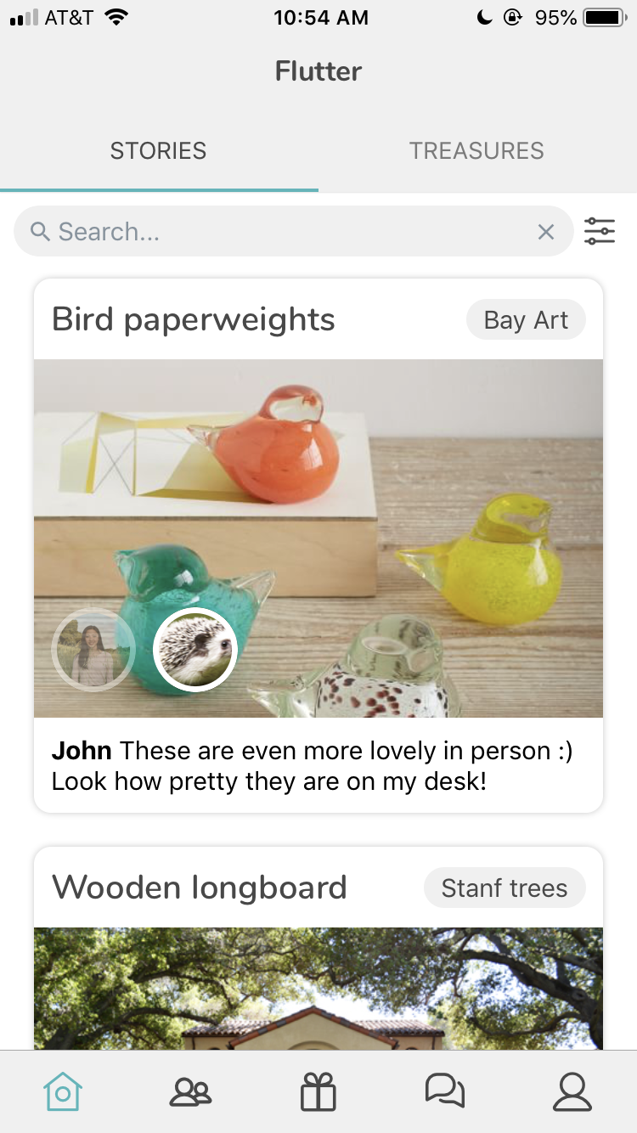
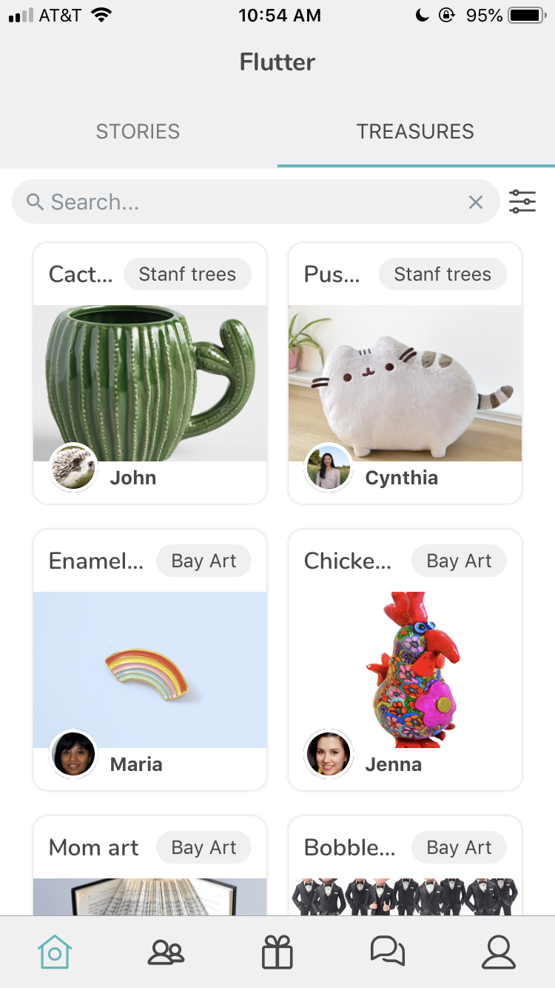
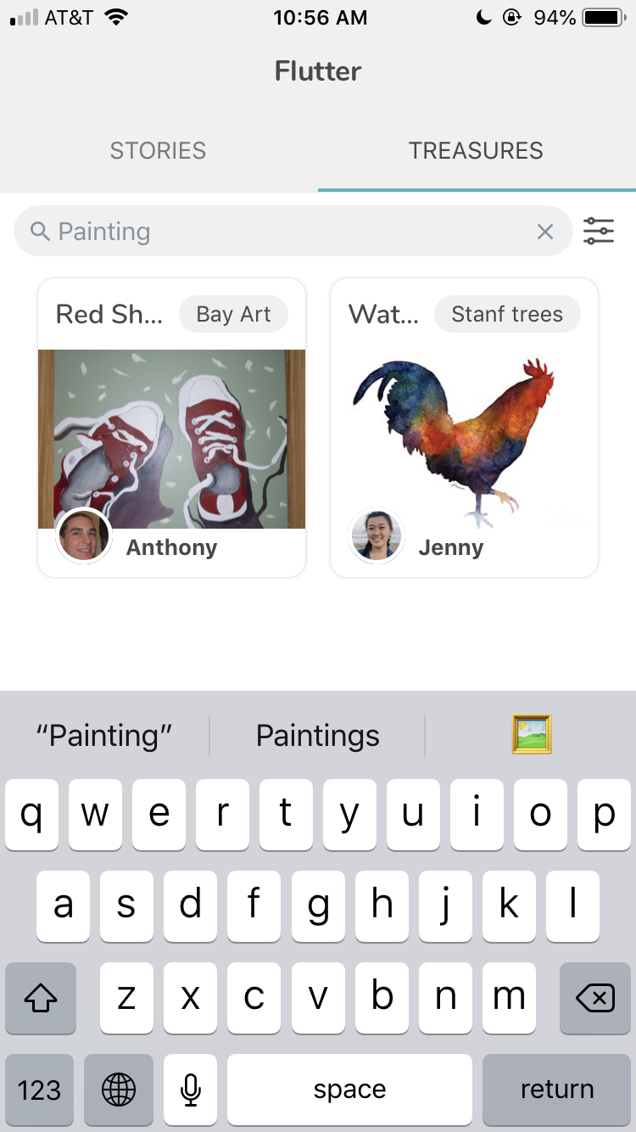
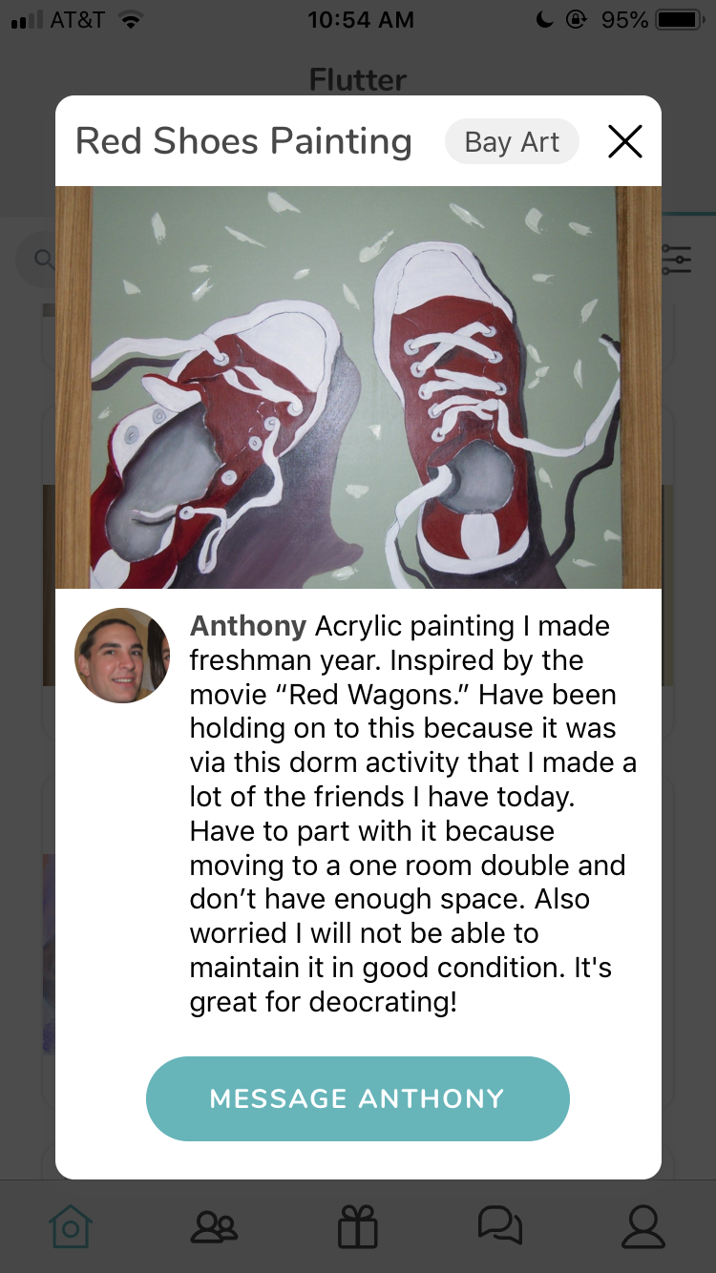
method
results
discussion
task 1: finding a specific item

Slide 36
method
results
discussion
task 1: finding a specific item
average total time
(average total time - outliers)
* time to tap treasures tab
errors
hesitation
starting over
74.3 s
39.5 s
58.1 s
2
5
3
prev: 46 s
prev: 38 s
prev: 1
prev: 3
prev: 1

Slide 37
method
results
discussion
task 1: finding a specific item
average total time
(average total time - outliers)
* time to tap treasures tab
errors
(hesitation - outlier x)
(starting over - outlier x)
74.3 s
39.5 s
58.1 s
2
2
0
prev: 46 s
prev: 38 s
prev: 1
prev: 3
prev: 1

Slide 38
method
results
discussion
task 1: finding a specific item
fairly intuitive for 5/6 participants.
to navigate to the item:
1/6 participants used the community filter
1/6 participants used the search bar
3/6 participants used the ‘communities’ tab
4/6 participants scrolled through
2
1
1
2
4
3
4
3

Slide 39
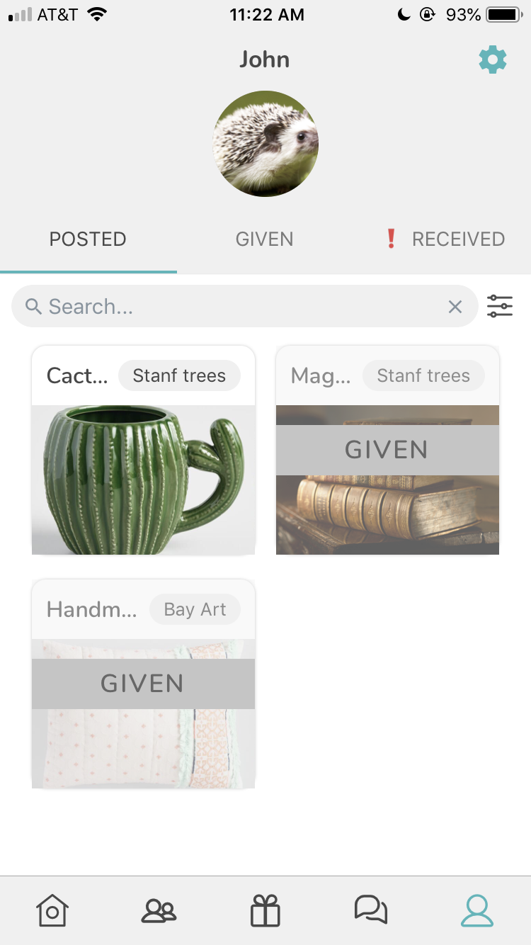
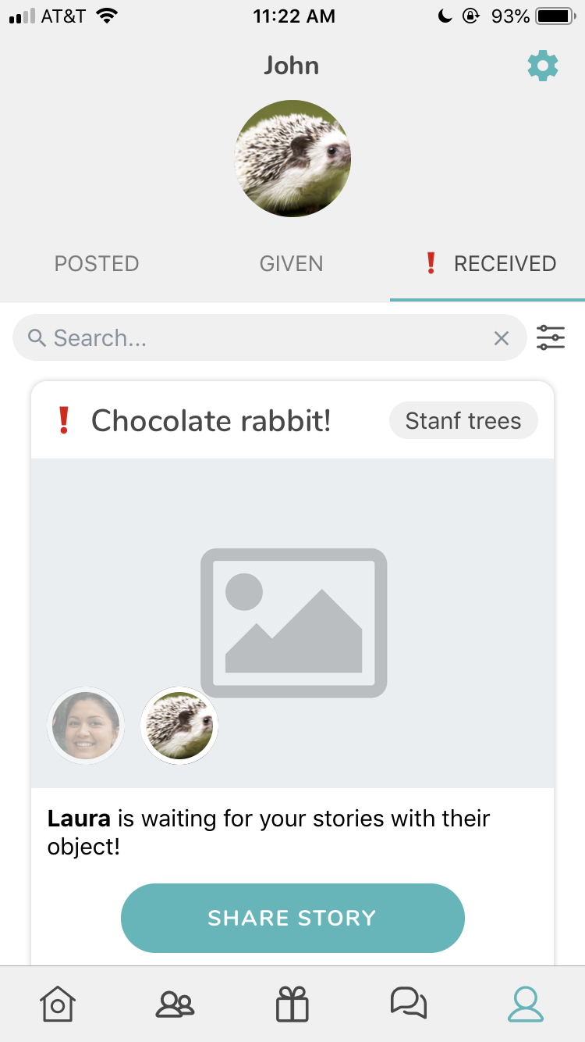
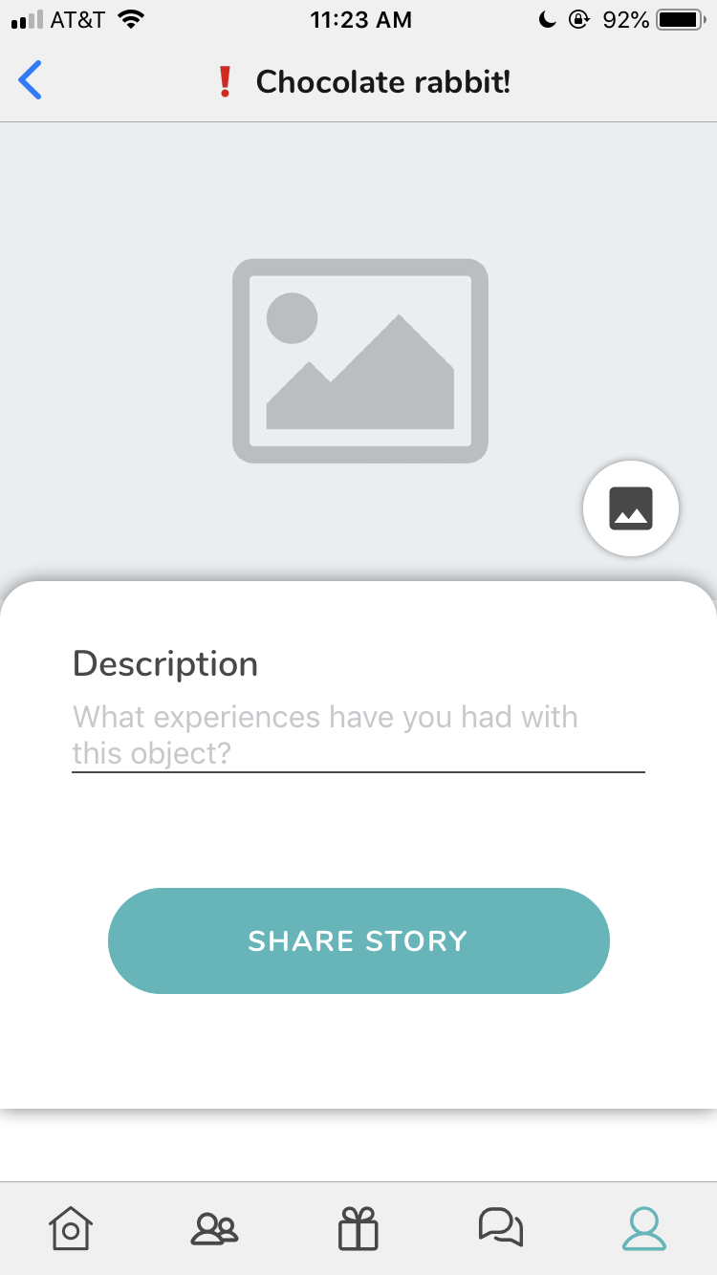
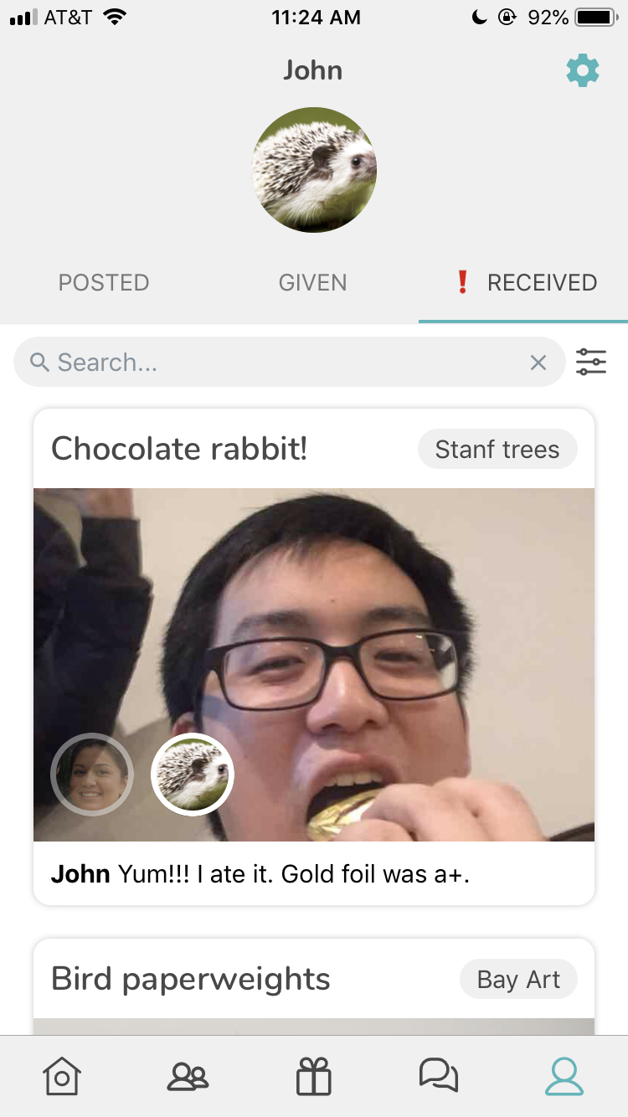
method
results
discussion
task 2: respond to an unfinished story

Slide 40
method
results
discussion
task 2: respond to an unfinished story
average total time
(average total time - outliers)
* time to tap profile -> received tab
(received tab - outliers)
errors
hesitation
starting over
119.8 s
69.8 s
58.1 s
33.5 s
6
1
0
prev: 96 s
prev: 1
prev: 5
prev: 1

Slide 41
method
results
discussion
task 2: respond to an unfinished story
4/6 participants wanted to take a picture in-app
4/6 participants were confused about the difference between profile vs. public

Slide 42
method
results
discussion
task 2: respond to an unfinished story
4/6 participants wanted to take a picture in-app
4/6 participants were confused about the difference between profile vs. public

Slide 43
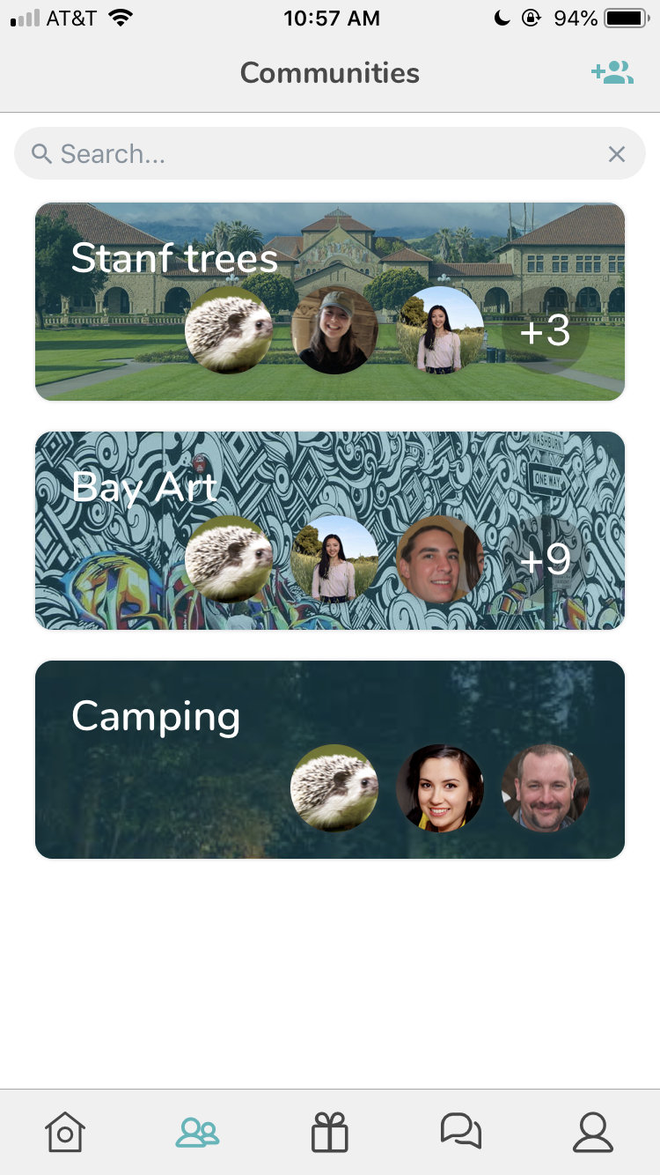
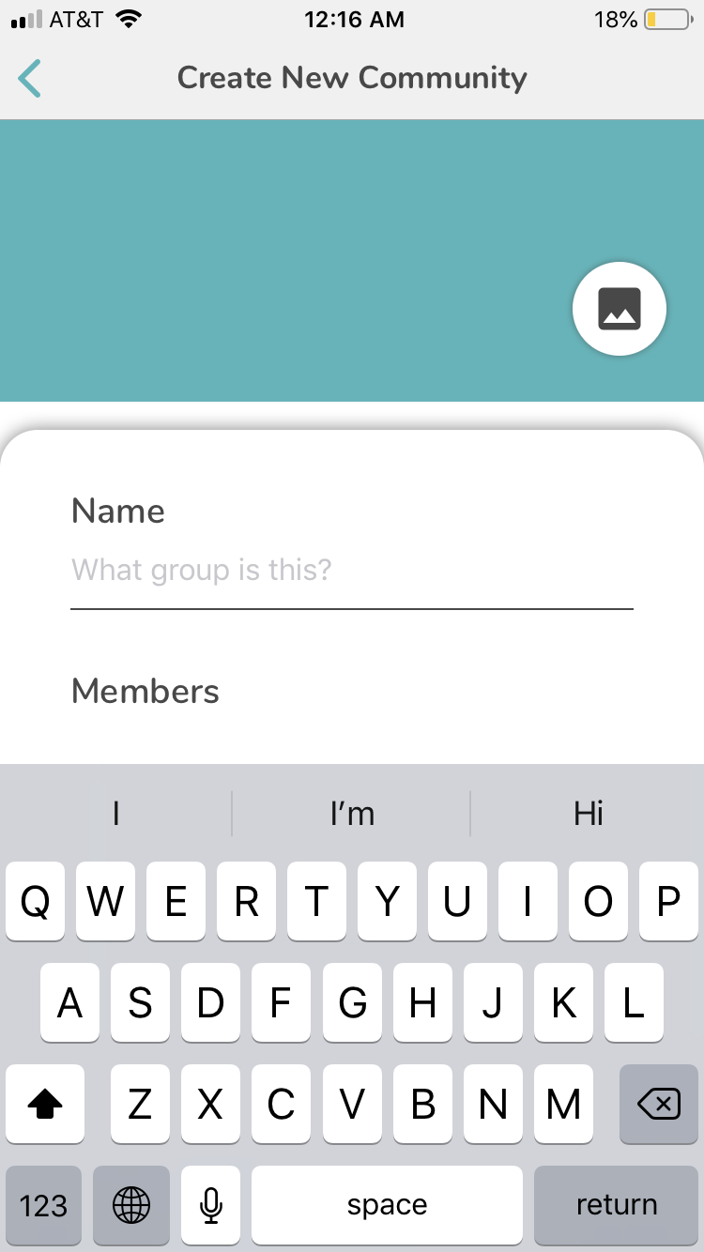
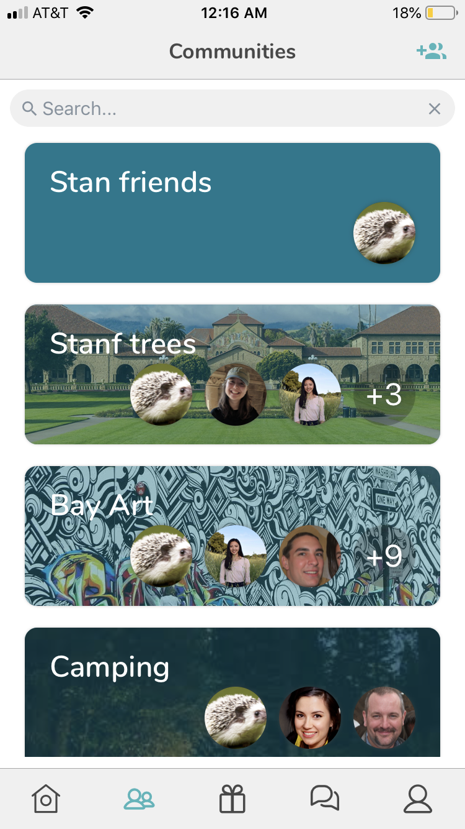
method
results
discussion
task 3: give a posted item to a friend
subtask 3a: create a new community

Slide 44
method
results
discussion
task 3: give a posted item to a friend
subtask 3a: create a new community
average total time
errors
hesitation
starting over
69.6 s
5 (from one participant)
0
0
(new)

Slide 45
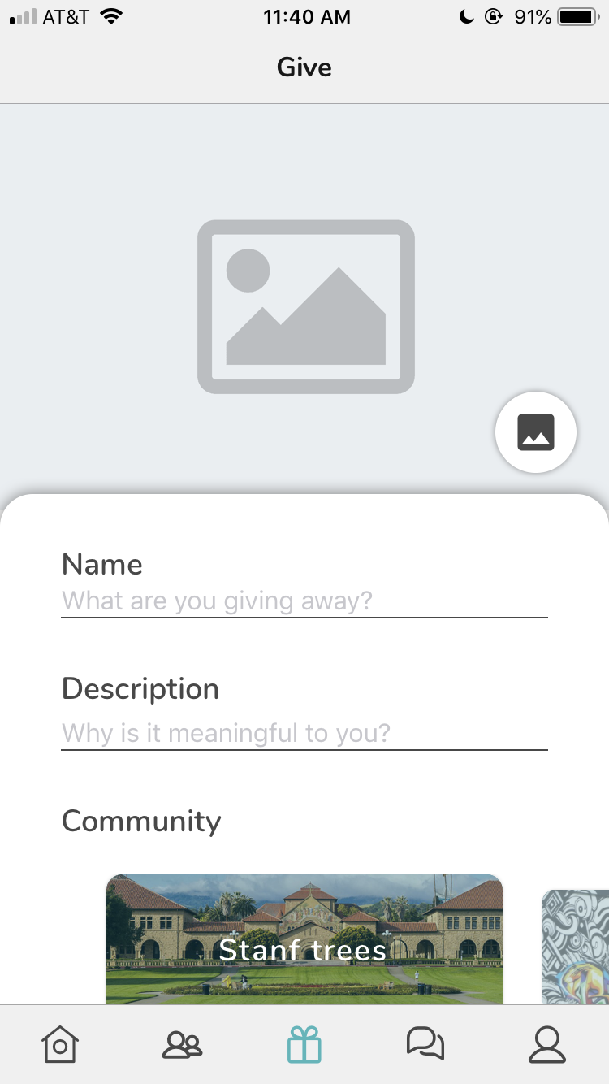
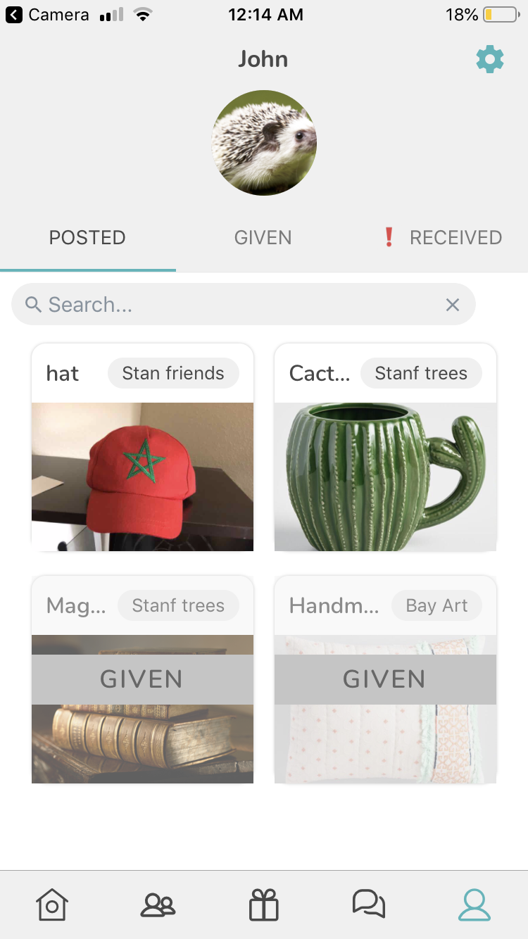
method
results
discussion
task 3: give a posted item to a friend
subtask 3b: post item

Slide 46
method
results
discussion
task 3: give a posted item to a friend
subtask 3b: post item
average total time
(average total time - outliers)
errors
hesitation
starting over
134.2 s
86.8 s
4
2
1
prev: 156 s
prev: 1
prev: 5
prev: 0

Slide 47
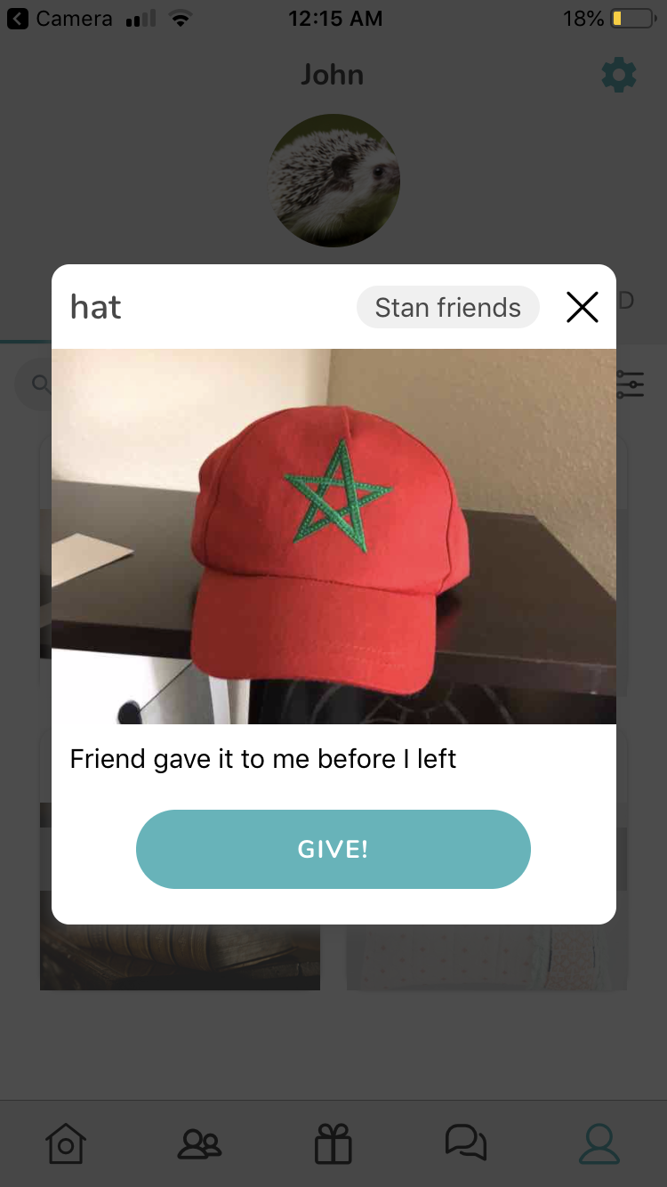
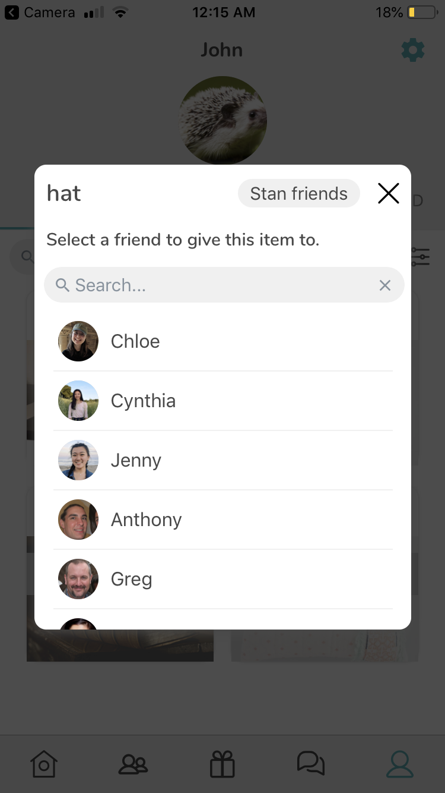
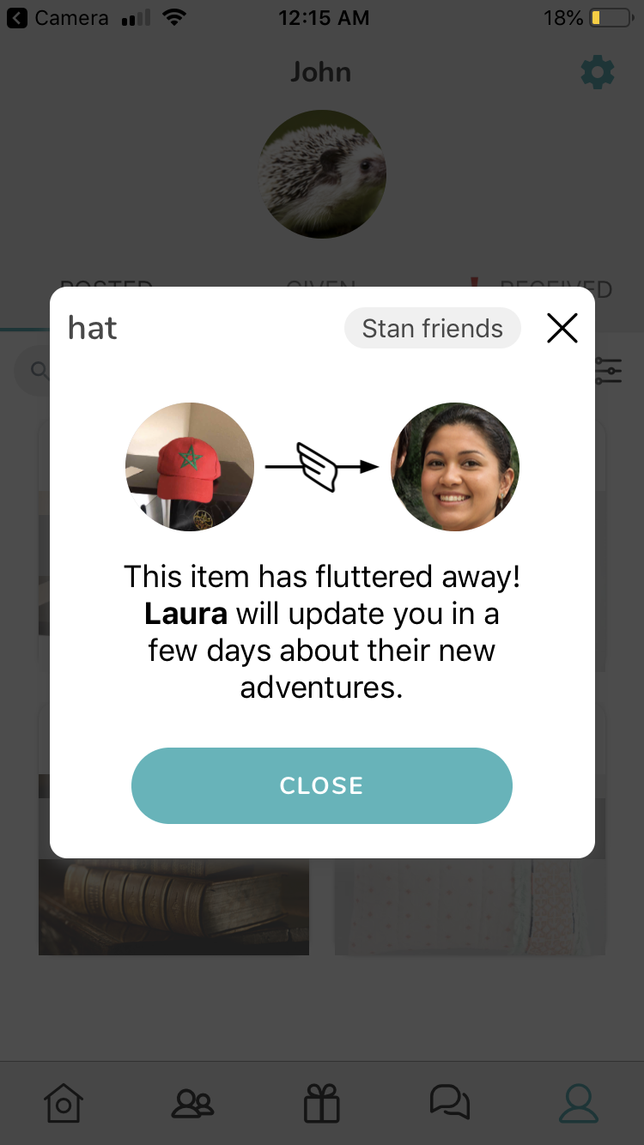
method
results
discussion
task 3: give a posted item to a friend
subtask 3c: give item to a friend in-app

Slide 48
method
results
discussion
task 3: give a posted item to a friend
subtask 3c: give item to a friend in-app
average total time
errors
hesitation
starting over
124.8s
4
3
6
(new)

Slide 49
method
results
discussion
task 3: give a posted item to a friend
subtask 3c: give item to a friend in-app
average total time
(errors - outlier x)
hesitation
(starting over - outlier x)
124.8s
1
3
2
(new)

Slide 50
method
results
discussion
task 3: give a posted item to a friend
3a: create new community
fairly intuitive; 1/6 participants did not do
3b: post item
2/6 participants went to profile/treasures to post the item
3c: give item to a friend in-app
2/6 participants forgot who they promised item to in-chat

Slide 51
method
results
discussion
task 3: give a posted item to a friend
3a: create new community
fairly intuitive; 1/6 participants did not do
3b: post item
2/6 participants went to profile/treasures to post the item
3c: give item to a friend in-app
2/6 participants forgot who they promised item to in-chat

Slide 52
method
results
discussion
task 3: give a posted item to a friend
3a: create new community
fairly intuitive; 1/6 participants did not do
3b: post item
2/6 participants went to profile/treasures to post the item
3c: give item to a friend in-app
2/6 participants forgot who they promised item to in-chat

Slide 53
discussion
method
method
results
results
discussion
discussion

Slide 54
difficulties: participants do not behave as predicted when instructions get broader. but this also leads to...
insights: testing in living spaces with participants thinking they actually have to give items away provides more genuine feedback.
50% of participants were extremely willing to give their items away (vs more ambiguous opinions in lab usability study)
method
method
results
results
discussion
discussion
in-situ insights

Slide 55
test new interface changes:
search + community filters
new task flows
chat
error handling
get insights about:
user base
applicability
mixed. search and community filters are made partially redundant by the ‘communities’ tab.
with these many options, users are confused by when to use communities/search/filter.
consolidate!
method
method
results
results
discussion
discussion
goals
verdict?
potential solution

Slide 56
test new interface changes:
search + community filters
new task flows
chat
error handling
get insights about:
user base
applicability
successful! (average times - outliers) were around the same, or much faster than, the previous round of testing.
method
method
results
results
discussion
discussion
goals
verdict?
39.5 s
69.8 s
86.8 s
38 s
98 s
156 s
vs

Slide 57
test new interface changes:
search + community filters
new task flows
chat
error handling
get insights about:
user base
applicability
mostly successful.
slight issue: in task 3c, 2/6 participants forgot who they promised their item to in-chat
make giving flow more seamless by allowing users to automatically select the specific receiver in-chat
method
method
results
results
discussion
discussion
goals
verdict?
potential solution

Slide 58
test new interface changes:
search + community filters
new task flows
chat
error handling
get insights about:
user base
applicability
successful!
4 potential errors caught before participants posted.
good job, error handling.
method
method
results
results
discussion
discussion
goals
verdict?

Slide 59

test new interface changes:
search + community filters
new task flows
chat
error handling
get insights about:
user base
applicability
successful!
4 potential errors caught before participants posted.
good job, error handling.
method
method
results
results
discussion
discussion
goals
verdict?

Slide 60
2/6 participants went to profile/treasures to post the item
place ‘give’ button in profile and in treasures tabs
method
method
results
results
discussion
discussion
more observations
potential solution

Slide 61

2/6 participants went to profile/treasures to post the item
place ‘give’ button in profile and in treasures tabs
method
method
results
results
discussion
discussion
more observations
potential solution

Slide 62
4/6 participants were confused about the difference between profile vs. public
create toggle at top of ‘home’ tab that flips to profile
method
method
results
results
discussion
discussion
more observations
potential solution

Slide 63
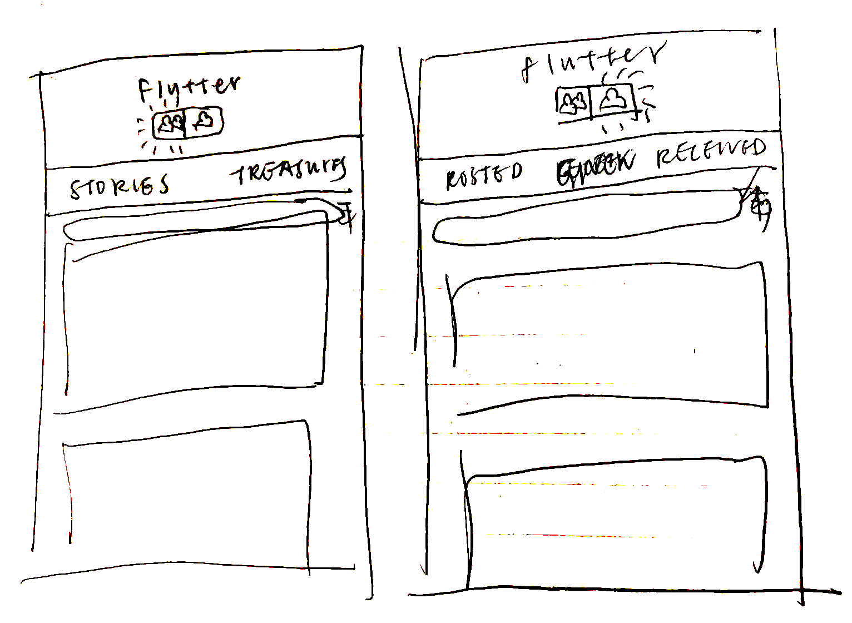
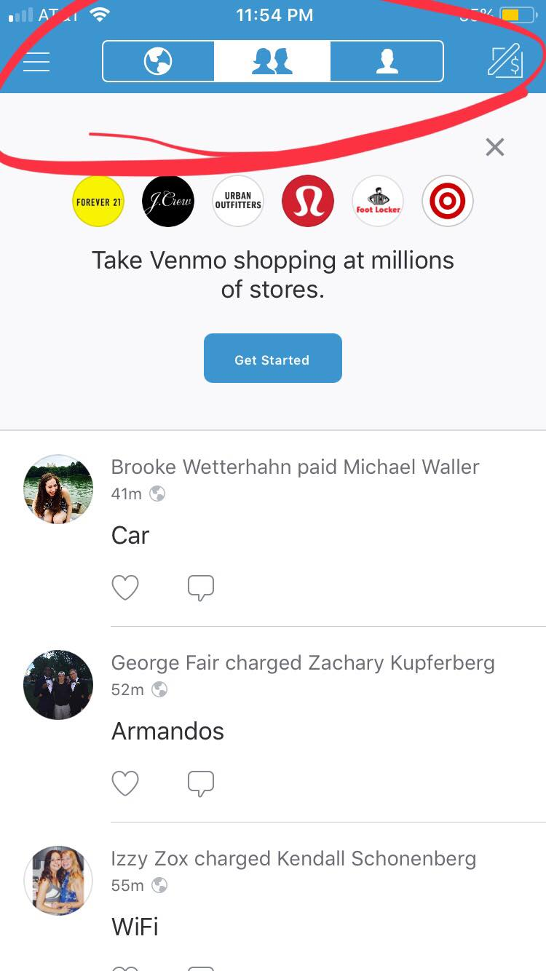
4/6 participants were confused about the difference between profile vs. public
create toggle at top of ‘home’ tab that flips to profile
method
method
results
results
discussion
discussion
more observations
potential solution

Slide 64
4/6 participants wanted to take a picture in-app
make this happen!
method
method
results
results
discussion
discussion
more observations
potential solution

Slide 65
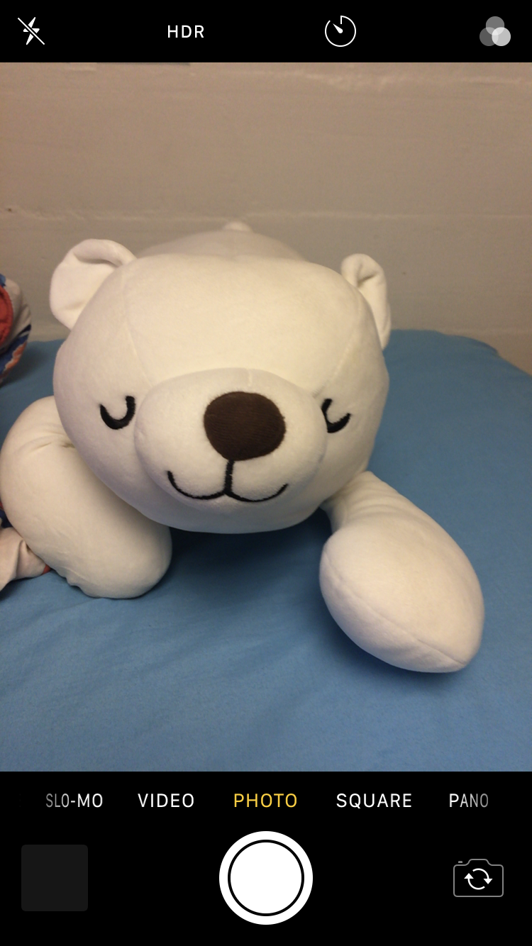
4/6 participants wanted to take a picture in-app
make this happen!
method
method
results
results
discussion
discussion
more observations
potential solution

Slide 66
test new interface changes:
search + community filters
new task flows
chat
error checking
get insights about:
user base
applicability
3/6 participants were extremely willing to give their items away.
5/6 participants were extremely willing to use this app again.*
* participants would use this app for:
clothing swaps
move-out day
* participants would use this app with:
geographical communities
themed communities
method
method
results
results
discussion
discussion
goals
verdict?

Slide 67
test new interface changes:
search + community filters
new task flows
chat
error checking
get insights about:
user base
applicability
primary user base: undergrad students found the app most intuitive/useful.
however...
though participant x had a significant amount of trouble navigating the app, he was extremely willing to use this app to declutter.
onboarding process for accessibility
method
method
results
results
discussion
discussion
goals
verdict?
potential solution

Slide 68
dorm testing during move-out or everyday use
long term study during period of transition
method
method
results
results
discussion
discussion
future testing

Slide 69
field usability test of 2nd hi-fi prototype
results
general success with app
insights
communities + filters
camera
user base + applicability
method
method
results
results
discussion
discussion
summary
thanks for your time!

